Slide 1
Where are we now?
Tools in our toolbox:
Integral Tables
Substitution method
New tools:
Integration by parts
Partial fractions

Slide 2
Math 152 – Lesson 12
Lesson | Topic | Reading | Homework
11 | GR #1
12 | Integration by Parts | 7.1 | 5, 12, 67
13 | Integration of Rational Functions by Partial Fractions | 7.4 | 1,7,19
Objectives:
Understand that Integration by Parts (IBP) is derived from reversing product rule derivatives
Recognize when IBP is an appropriate for evaluating an integral
Evaluate a given integral using IBP

Slide 3
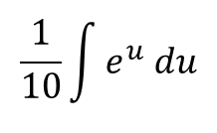
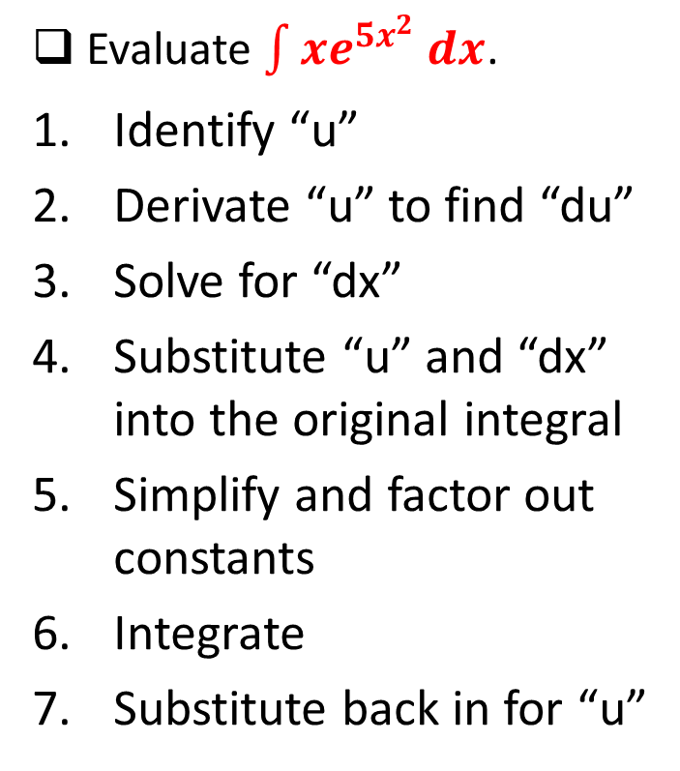
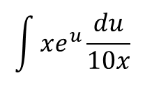
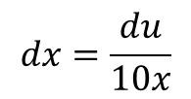

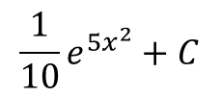

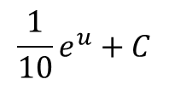
“Undoing” The Chain Rule
Evaluate $\int{xe^{{5x}^{2}} dx}$.
Identify “u”
Derivate “u” to find “du”
Solve for “dx”
Substitute “u” and “dx” into the original integral
Simplify and factor out constants
Integrate
Substitute back in for “u”
$$u=5x^{2}$$
$$du=10x dx$$
$$dx=\frac{du}{10x}$$
$$\int{xe^{u}\frac{du}{10x}}$$
$$\frac{1}{10}\int{e^{u} du}$$
$$\frac{1}{10}e^{u}+C$$
$$\frac{1}{10}e^{5x^{2}}+C$$
Notes:
Un-doing the chain rule

Slide 4
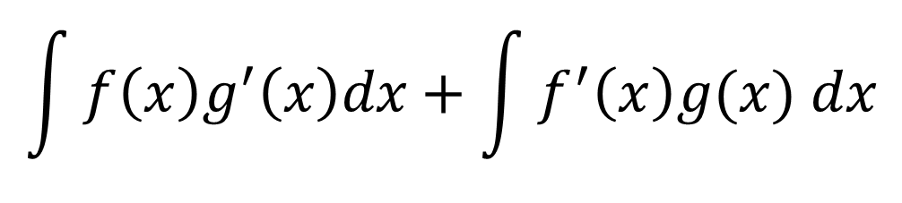
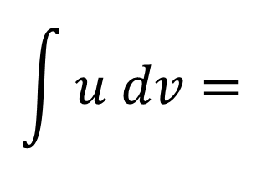

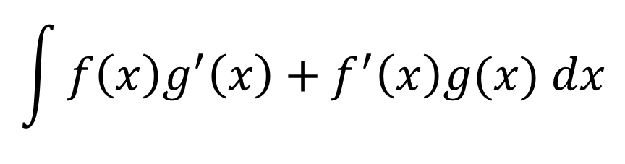







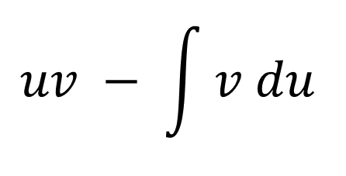
“Undoing” The Product Rule
$$\frac{d}{dx}f\left(x\right)g(x)$$
$$\int{f\left(x\right)g^{′}\left(x\right)+f^{′}\left(x\right)g(x) dx}$$
$$f\left(x\right)g(x)$$
$$=$$
$$f\left(x\right)g^{′}\left(x\right)+f^{′}\left(x\right)g(x)$$
$$=\int{f\left(x\right)g^{′}\left(x\right)dx}$$
$$\int{f\left(x\right)g^{′}\left(x\right)dx+\int{f^{′}\left(x\right)g(x) dx}}$$
$$\int{f^{′}\left(x\right)g\left(x\right) dx}$$
$$f\left(x\right)g(x)$$
$$=$$
$$f\left(x\right)g(x)$$
$$uv − \int{v du }$$
$$\int{u dv=}$$
$$−$$
Notes:
UltraViolet VooDu

Slide 5
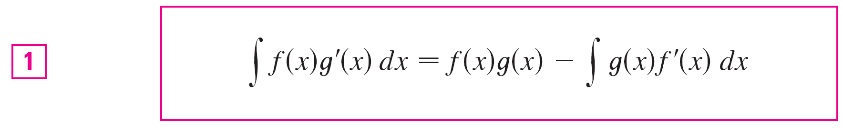
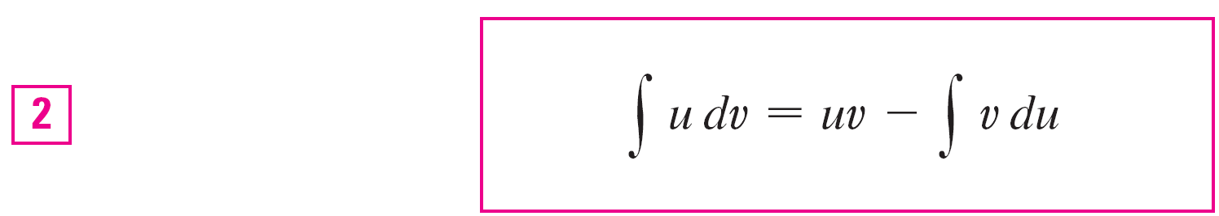
Integration by Parts (IBP)
The formula for IBP:
However, most people remember:
where u = f (x), v = g (x), du = f ′(x)dx, and dv = g ′(x)dx

Slide 6



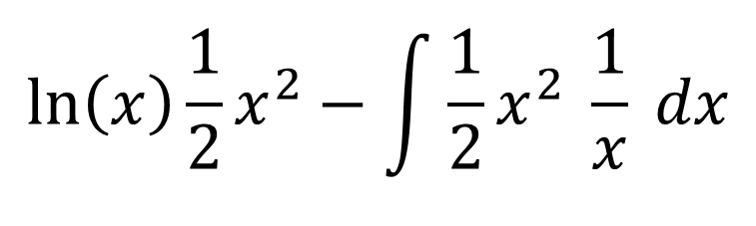







Steps to Integration by Parts
$$\int{x\ln\left(x\right)dx}=$$
$$\int{u dv =}$$
$$\ln\left(x\right)\frac{1}{2}x^{2}−\int{\frac{1}{2}x^{2} \frac{1}{x} dx}$$
$$uv−\int{v du}$$
Log PoET:
Log – Logarithm, Po – Polynomial, E – Exponential, T - Trigonometric
$$u =$$
$$v =$$
$$\frac{1}{2}x^{2}$$
$$ln⁡(x)$$
$$du =$$
$$\frac{1}{x}dx$$
$$dv =$$
$$x dx$$

Slide 7



Example 1
Find ∫ x sin x dx
∫ x sin x dx = x(–cos x) – ∫ (–cos x) dx
= –x cos x + ∫ cos x dx
= –x cos x + sin x + C
$$u =$$
$$x$$
$$v =$$
-cos(x)
$$du =$$
$$dx$$
$$dv =$$
$$sin⁡(x) dx$$

Slide 8
Example 1- Double Check
d/dx(–x cos(x) + sin(x) + C) =
-1cos(x) – x (-sin(x)) +cos(x)=
xsin(x) what we started with

Slide 9
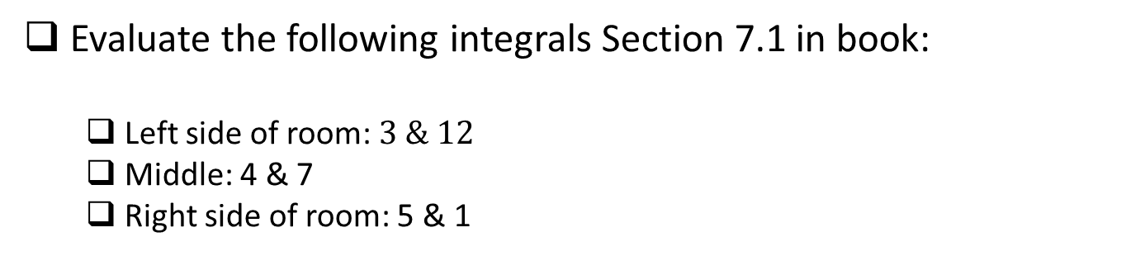
Board Work
Evaluate the following integrals Section 7.1 in book:
Left side of room: $3 \& 12$
Middle: 4 & 7
Right side of room: 5 & 1
Notes:
7) Is 7.1, #67

Slide 10
Backups

Slide 11
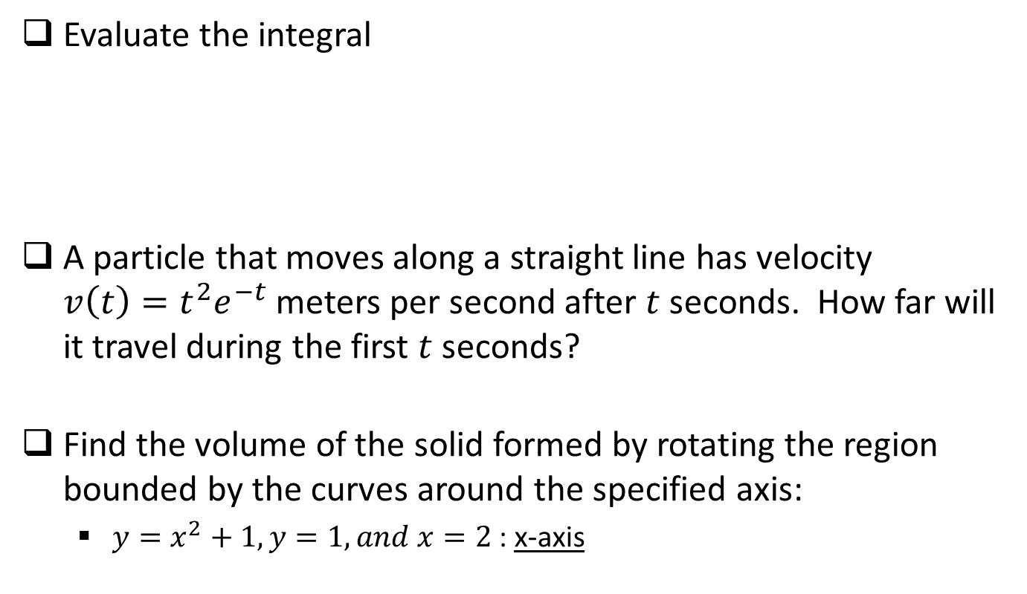
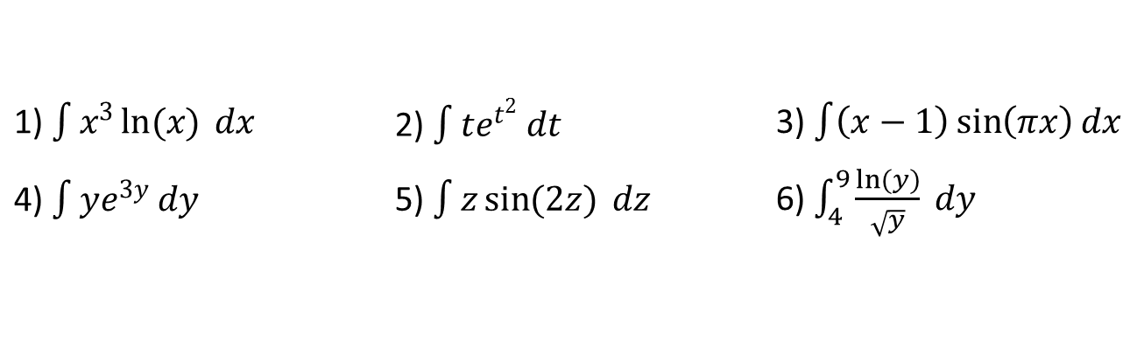
Board Work
Evaluate the integral
A particle that moves along a straight line has velocity $v\left(t\right)=t^{2}e^{−t}$ meters per second after $t$ seconds. How far will it travel during the first $t$ seconds?
Find the volume of the solid formed by rotating the region bounded by the curves around the specified axis:
$y=x^{2}+1, y=1, and x=2$: x-axis
1) $\int{x^{3}\ln{(x)} dx}$ | 2) $\int{te^{t^{2}} dt}$ | 3) $\int{\left(x−1\right)\sin\left(πx\right)dx}$
4) $\int{ye^{3y} dy}$ | 5) $\int{z\sin{(2z)} dz}$ | 6) $\int_{4}^{9}{\frac{\ln{(y)}}{\sqrt{y}} dy}$
Notes:
7) Is 7.1, #67

Slide 12
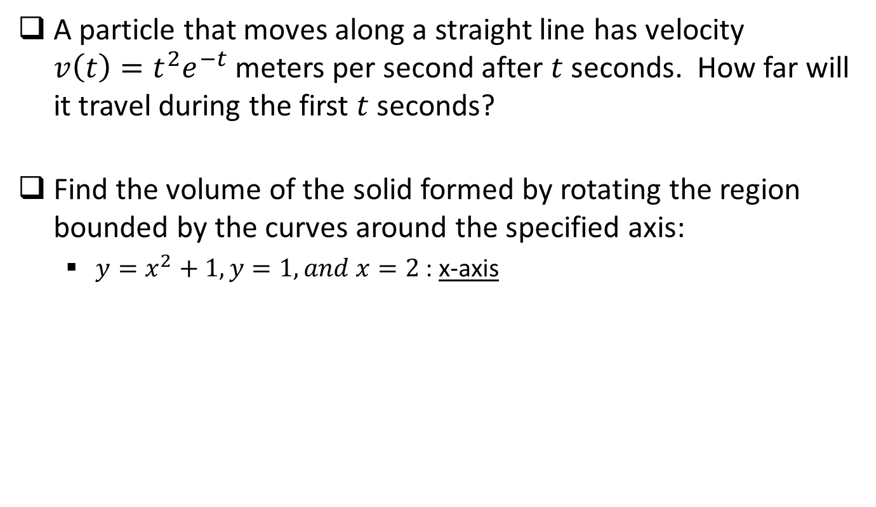
Review
A particle that moves along a straight line has velocity $v\left(t\right)=t^{2}e^{−t}$ meters per second after $t$ seconds. How far will it travel during the first $t$ seconds?
Find the volume of the solid formed by rotating the region bounded by the curves around the specified axis:
$y=x^{2}+1, y=1, and x=2$: x-axis

Slide 13
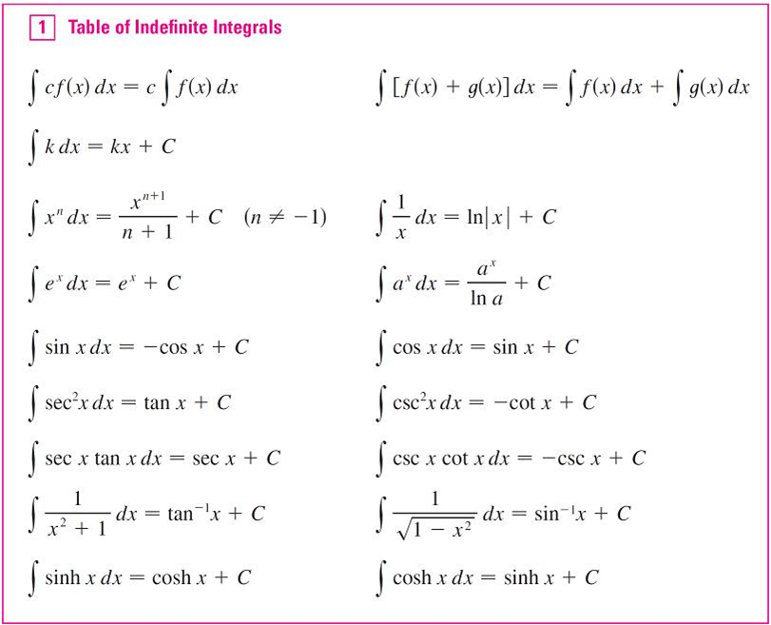
Integral Table

Slide 14

Board Work
Evaluate the following integrals:
Left side of room: $\int{x^{3}\ln{(x)} dx}$ and $\int{te^{t^{2}} dt}$
Middle: $\int{\left(x−1\right)\sin\left(πx\right)dx}$ and $\int{ye^{3y} dy}$
Right side of room: $\int{z\sin{(2z)} dz}$ and $\int_{4}^{9}{\frac{\ln{(y)}}{\sqrt{y}} dy}$
Notes:
7) Is 7.1, #67

